Slide 1
Lecture 2a
Protocols and Layers

Slide 2
So far and what next…
We described a hierarchy of network types based on their geographical service area
Access, metro, long-haul
At a high level, we looked at three communication scenarios
Greeting card, landline phone call, browsing Amazon.com
What all happens to make the browser display the web page?
We look at the idea of protocols and layering in this context

Slide 3
The Network Core
Mesh of interconnected routers or switches
The fundamental question: how is data transferred through net?
Circuit switching: dedicated circuit per call: telephone networks
Packet-switching: data sent through nework in discrete “chunks”
[Circuits: network resources are chopped up in units of “circuits”
Packets: data is chopped up in units of “packets”]
Figure from Kurose & Ross

Slide 4
Revisiting the Landline Voice Call – Circuit Switching
Slide modified from Agrawal
Resources are “dedicated” for the duration of the voice call
A circuit is an electronic closed-loop path among two or more points
Circuit switched networks typically bill by the minute
Telegraph

Slide 5
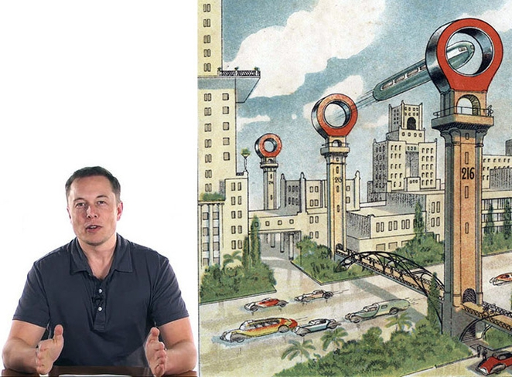
Source: http://media.treehugger.com/assets/images/2013/07/elon-musk-hyperloop.jpg.662x0_q100_crop-scale.jpg
Elon Musk and the Hyperloop

Slide 6
Multiplexing
Combines multiple flows of information on a common transmission medium
The cost of the transmission medium is excessive
Laying a highway is very expensive
Digging to lay cables is also expensive
Can the same cable carry many communication flows? If so how?
Imagine laying 200 cables to support 200 TV channels

Slide 7
Switching
Slide modified from Agrawal
Switching
Reduce the number of resources
Think of a “shared” road, but still dedicated at any given time
What happens if a user E is added to the systems below?
How about (near) simultaneous communications?
How many wires?
Notes:
Multiplexing
One wire carries multiple signals
In 1874, the quadruplex telegraph developed by Thomas Edison transmitted two messages in each direction simultaneously, for a total of four messages transiting the same wire at the same time
Circuit switching
One wire connects to multiple destinations
March 10, 1891, Strowger switch patented
Tampa connection - Buried in St. Pete - http://en.wikipedia.org/wiki/Almon_Strowger

Slide 8
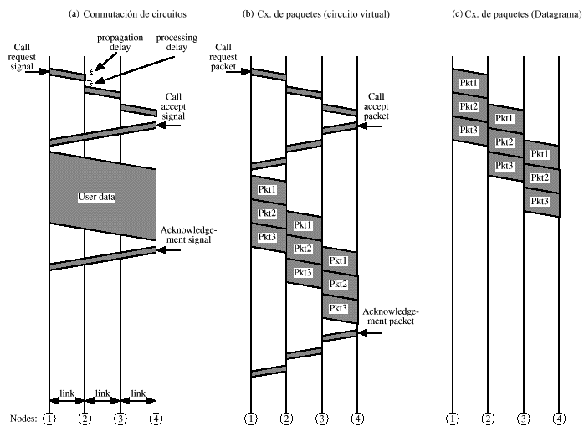
Approaches to switching
Circuit Switching
Packet switching (Virtual circuit)
Packet Switching (Datagram)
1st
Notes:
Fig OK (stallings)

Slide 9
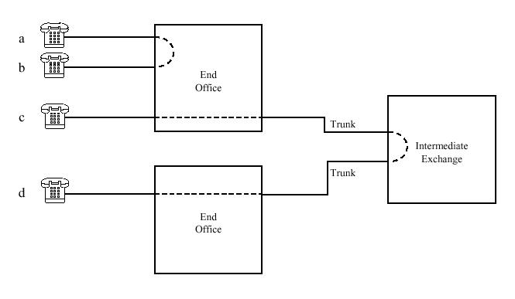
Circuit Switching
a ↔ b
Illustrates a
“local call”
c ↔ d
Illustrates a
“long distance call”
Notes:
Fig OK

Slide 10
Circuit switching towards packet switching
Slide modified from Agrawal
Over 100 years of Circuit Switched Networks

Slide 11
Why Packet Switching?
Slide modified from Agrawal
Increase in interactive data traffic (as opposed to voice traffic)
Increased “burstiness” of data (high ratio of peak usage to mean usage)
Example: Typical browsing behavior
Packet switching enables efficient utilization of communication links
Averages the needs of a large numbers of users
Aggregation and the law of large numbers
3-100 times more efficient than circuit switching
Computing cost Vs communication cost
Uses complete bandwidth
Eliminates single points of failure in data communication systems

Slide 12
Packetization overview
Slide modified from Agrawal
Packetization is
Breaking down user data into small segments
Packaging these segments appropriately so that they can be delivered and reassembled across the network
Circuit switching sends a continuous stream of data
Each segment or packet has two parts
Data to be delivered
“Overhead” required for successful delivery and integration with other packets
User Data
Seg
Seg
Seg
1
2
3
1
Header

Slide 13
Packets analogy
Slide modified from Agrawal
In the end, these are all “bits”
Source Address
Destination Address
Other Info
PAYLOAD

Slide 14
Packetization in retail
Slide modified from Agrawal
Ikea example
Priority mail example
Postal mail is similar to packet switching in some respects

Slide 15
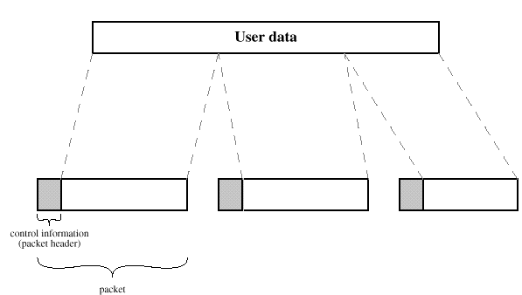
Packet Switching aka “Routing”
Packets:
Datagrams: Each packet is treated independently
Virtual circuit: A “path” is established
before any packets are sent
Notes:
Fig OK

Slide 16
Approaches to switching
Circuit Switching
Packet switching (Virtual circuit)
Packet Switching (Datagram)
2nd
Notes:
Fig OK (stallings)

Slide 17
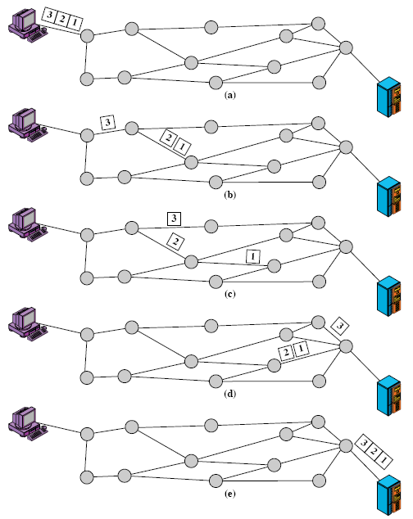
Packet Switching using datagrams
Successive packets may be
routed along different paths
And, may arrive out of order
Called “Routing”
(Layers 2 & 3) ⇒
& these nodes
are called “Routers”

Slide 18
Approaches to switching
Circuit Switching
Packet switching (Virtual circuit)
Packet Switching (Datagram)
3rd
Notes:
Fig OK (stallings)

Slide 19
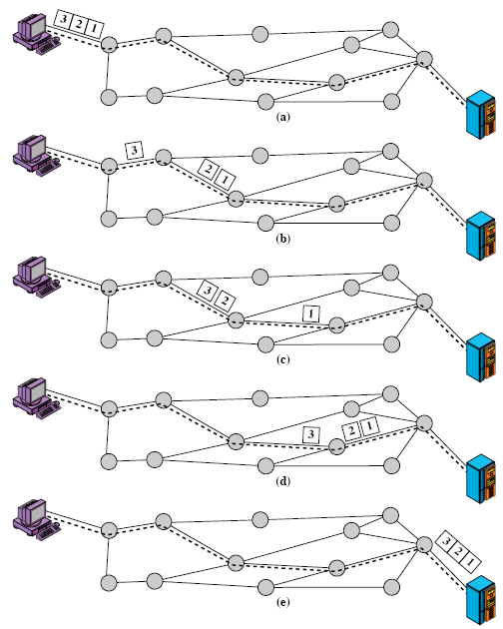
Packet Switching using virtual circuits
1st, select route
for all packets
All packets are
routed along this path
And arrive in order

Slide 20
Packet Switching vs Circuit Switching
Data transport over circuit-switch channels
Circuit is unused when there’s no traffic
Most of the time, if traffic is bursty (key strokes, file transfers)
About 2/3 of the time for (half-duplex) voice
End points must transmit/receive at constant fixed speed, limiting variety of devices that can be connected *(modem)
Congestion → calls are blocked (Mother’s Day)
Data transport using packet switching
Transmission medium is more efficiently used
Can send packets from several users over same link *(mux⇒)
Devices that transmit at different speeds can communicate with each other
Priority can be given to certain packets
Congestion → packets delayed, but accepted *(overflow)
*Over-simplified

Slide 21
Analysis
Circuit switching
Good for applications that cannot tolerate delay
Contention resolution by blocking
Can be inefficient for bursty traffic
Efficient if app market justifies custom network
Packet switching
Large messages can result in long delays → Packets
More efficient for bursty traffic
Contention resolution by delay (with some loss)
Commonly used in modern data networks

Slide 22
Comparison

Slide 23
Circuit Switching Again
Prior to communications, the “network” establishes the circuit (users not connected all the time)
Call Establishment
The circuit takes up resources
Bandwidth (time slots, frequency chunks) (what is bandwidth?)
The performance (e.g., delay) is predictable once the circuit is established
Imagine having a dedicated road, truck, gasoline and driver to carry a package to a destination
Resources are typically underutilized and wasted
Train tracks and hyperloops??
Performance metric is “call blocking”

Slide 24
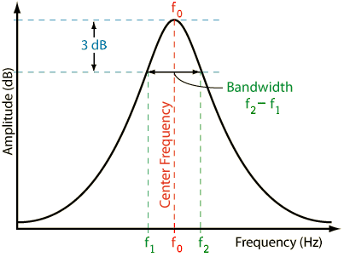
Bandwidth
Computer Science: a measurement of bit-rate (bit/s, kbit/s, Mbit/s, Gbit/s, etc.)
Wireless communications: measured in Hertz.
figure from: http://www.sengpielaudio.com/calculator-bandwidth.htm

Slide 25
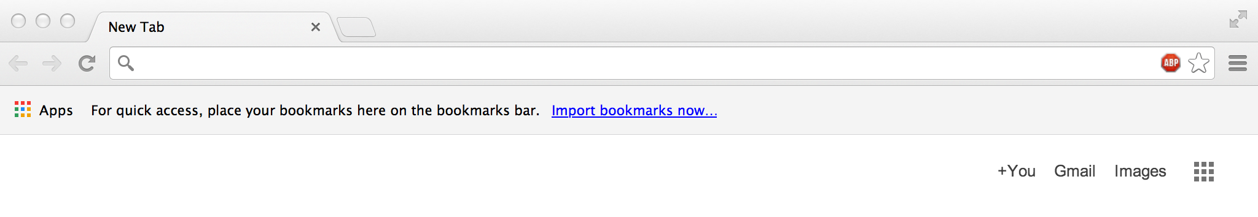
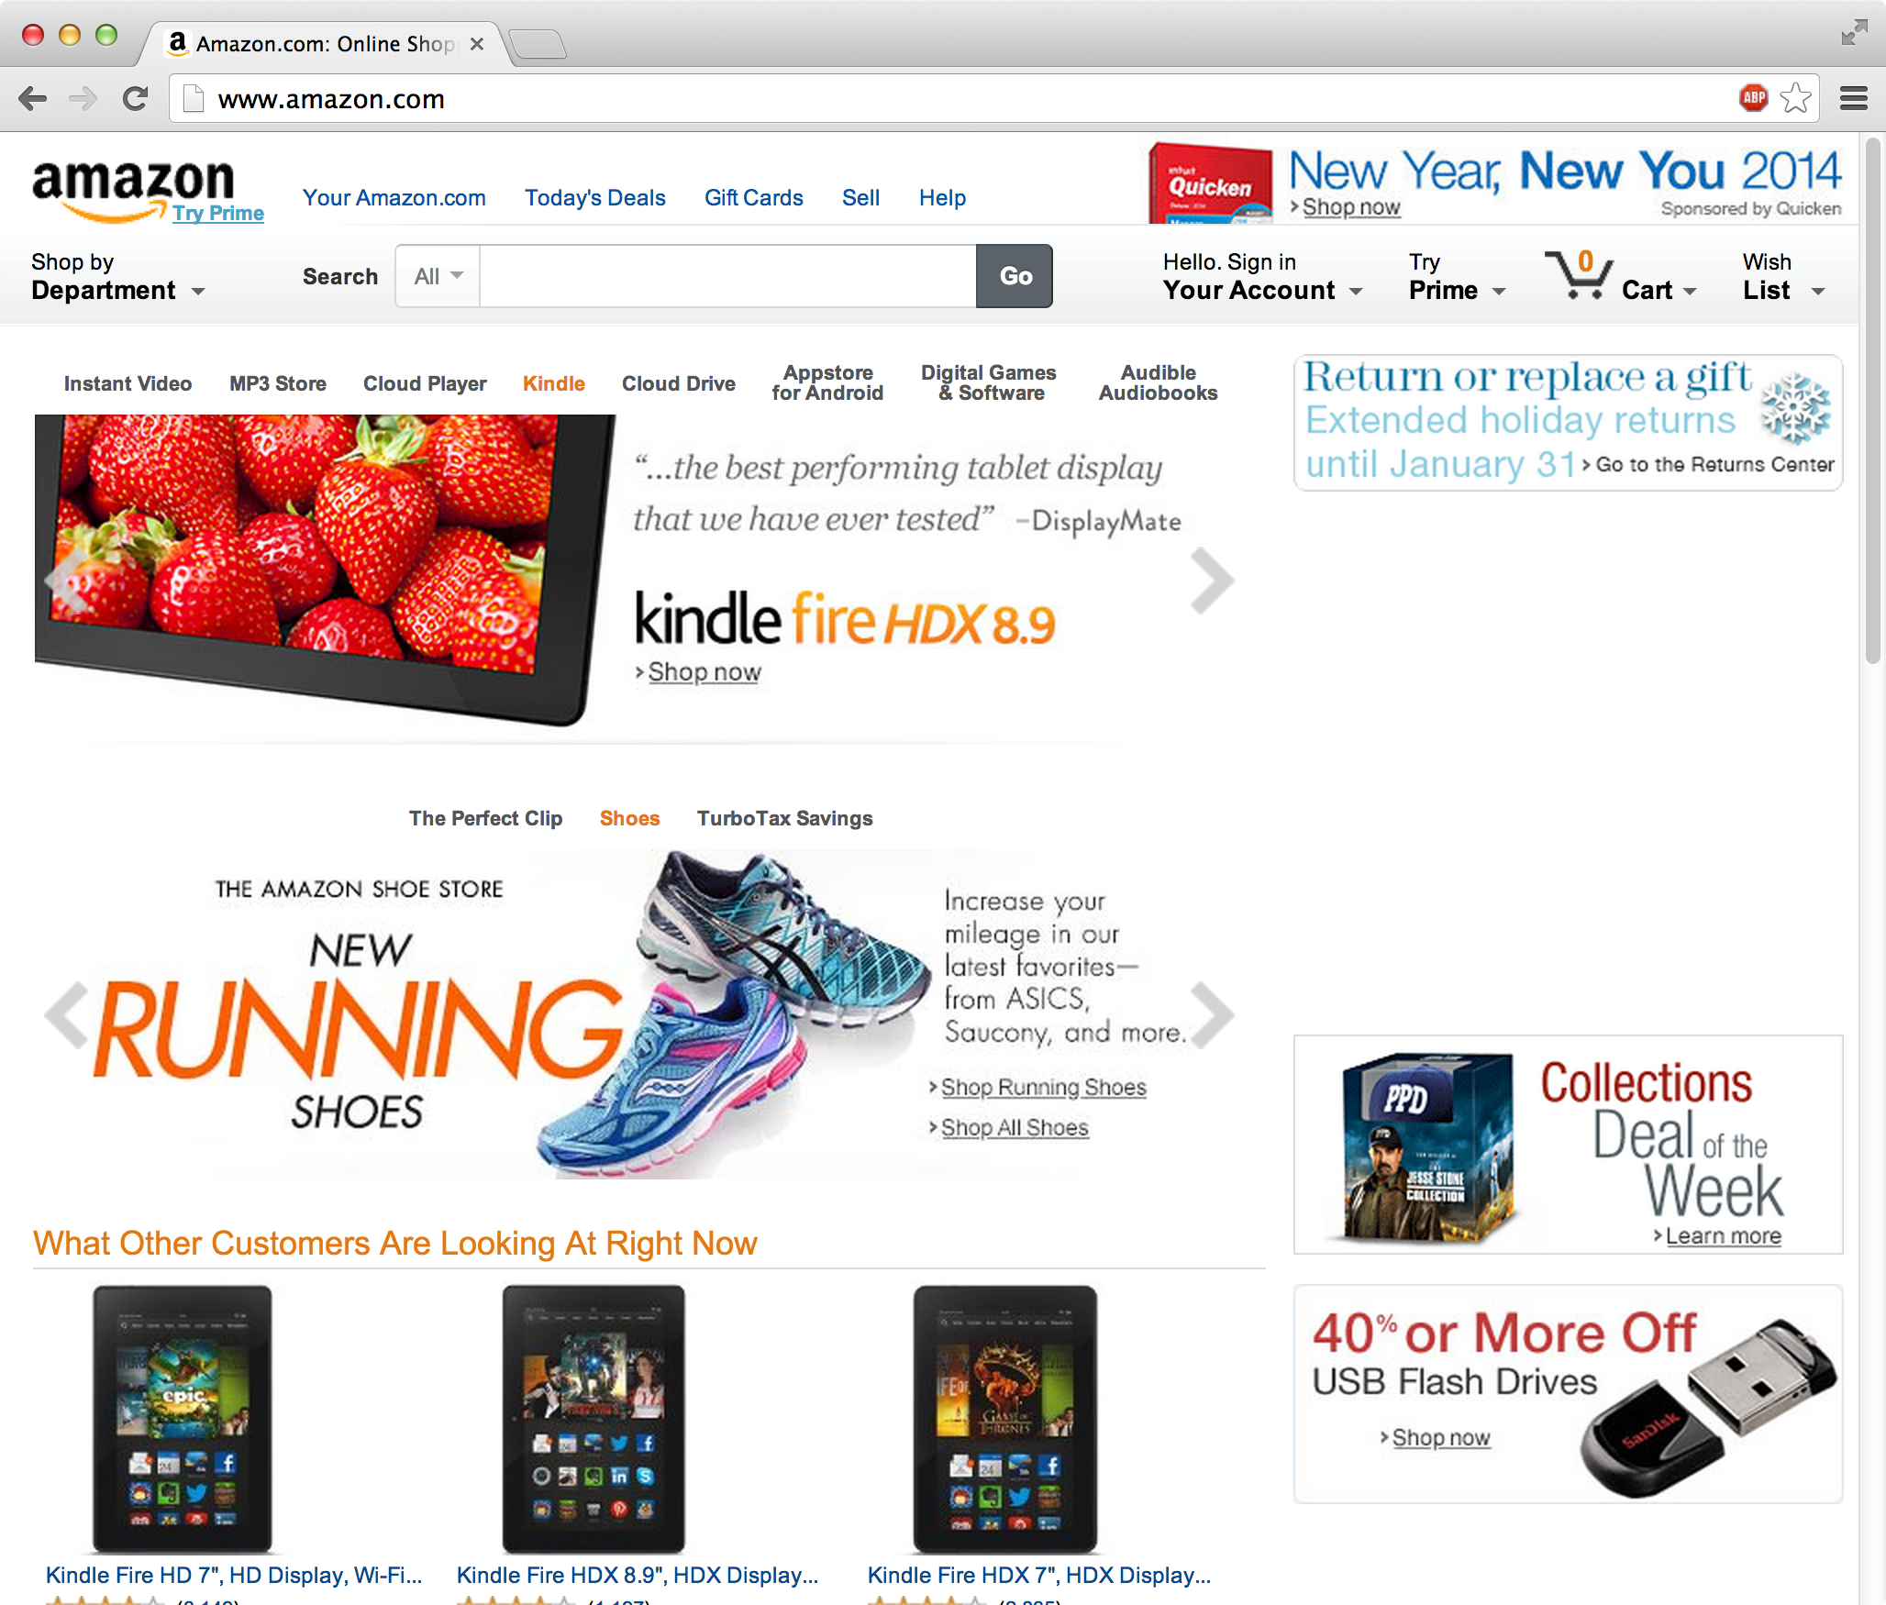
Revisiting Browsing Amazon.com
Boots her computer and
Opens browser
Browser is called the “client” software
Alice
“www.amazon.com” is the identity of “server”(s)
Types
http://www.amazon.com
Browser “loads” page
Always on!

Slide 26
Questions
How does the browser know what and where amazon.com is? (Addressing)
How does it “communicate” with amazon.com? (Routing & protocols)
How is it “always connected” to the Internet?
What if Alice is also browsing cnn.com at the “same” time? (Multiplexing)
How does the browser know if it has received the elements of the html page correctly? (Error control)

Slide 27
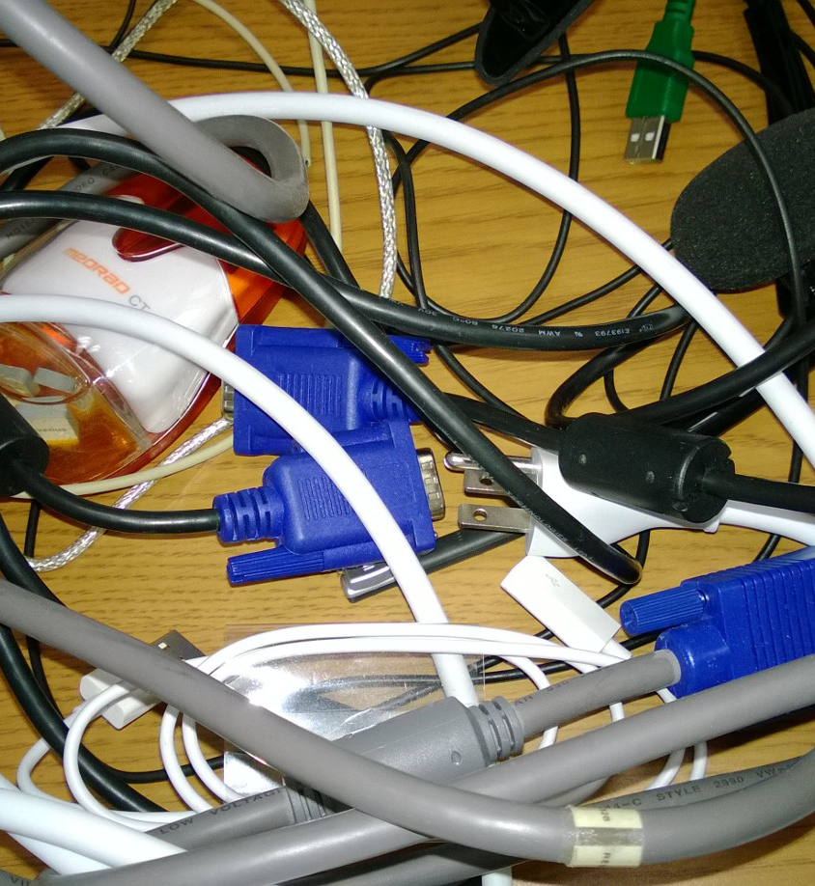
Slide from Agrawal

Slide 28
Packet switching
Slide modified from Agrawal
Network 2
Network 1
Router
Routing data using “addressed” packets so that a “channel” is occupied only during the transmission of the packet
Packet switches are called routers
Routers are devices used to interconnect two or more networks
Network resources are allocated (or used) as needed
Packet switched networks typically bill by the MB
Performance metrics are delay, jitter, throughput, packet loss rate
First packet transmission occurred on Oct 29, 1969, in California

Slide 29
Revisiting Greeting Card Scenario
There is a structured “flow”
between layers at each end
Alice writes greeting card to grandmom
Grandmom reads greeting card
Alice puts it in envelope
Grandmom removes from envelope
Alice drops envelope in mailbox
Grandmom retrieves envelope from mail
Mailman picks up the mail from box
Mail gets sorted
Transport
Mail gets sorted
Mailman delivers mail to mailbox
Truck carries mail to post office
Truck carries mail from post office
There is a one-to-one correspondence
between layers in the two end points

Slide 30
Layering
Slide modified from Agrawal
Arranging functionality in a hierarchical manner
Lower layers provide functions and services that support the functions and services of higher layers
Later: How we create and process packets
Example (corporate)
VPs help CEOs reach their goals
Managers help VPs reach their goals
Workers work with tools and machines help managers reach their goals
We will see that there are so called “protocol layers” in computer networks

Slide 31
Layering examples
Slide modified from Agrawal
Example (software)
Computer applications delegate many tasks to operating systems
Operating systems delegate tasks to “drivers” for execution
Revisit layering this week

Slide 32
Layering in packet switched networks
Figure from Agrawal shows a simplified view of layering
We will use this figure occasionally to put things in context
Applications
Network Protocol Stack

Slide 33
Processes
Software programs run as processes in an operating system
In Unix like operating systems (Mac OSX or Linux) you can use the ps command (process status) to list the processes
In Windows, you can use the task manager to look at the processes
host or
server
host or
server
controlled by
app developer
process
process
socket
socket
TCP with
buffers,
variables
TCP with
buffers,
variables
Internet
controlled
by OS (kernel)
Figure modified from Kurose and Ross

Slide 34
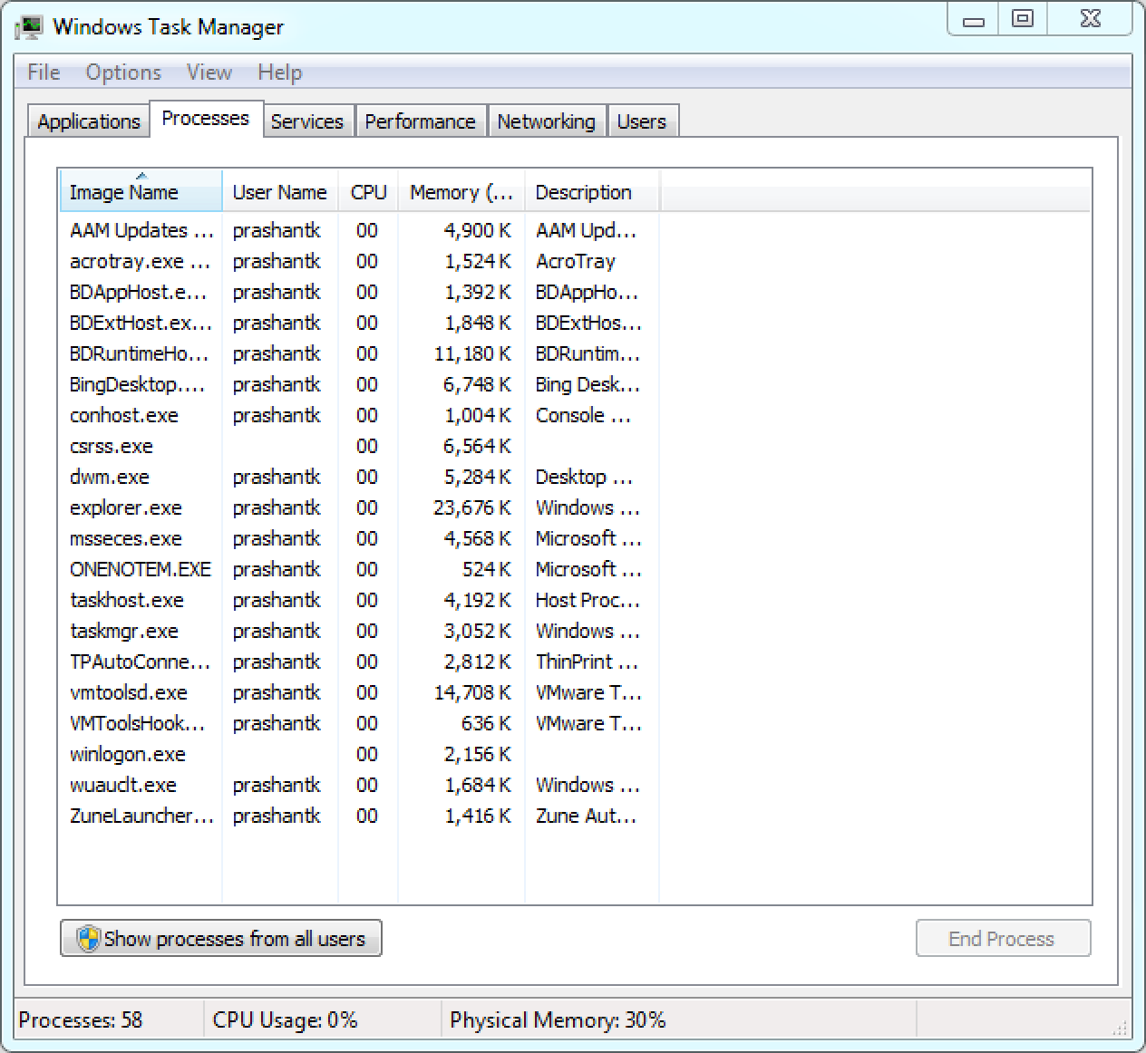
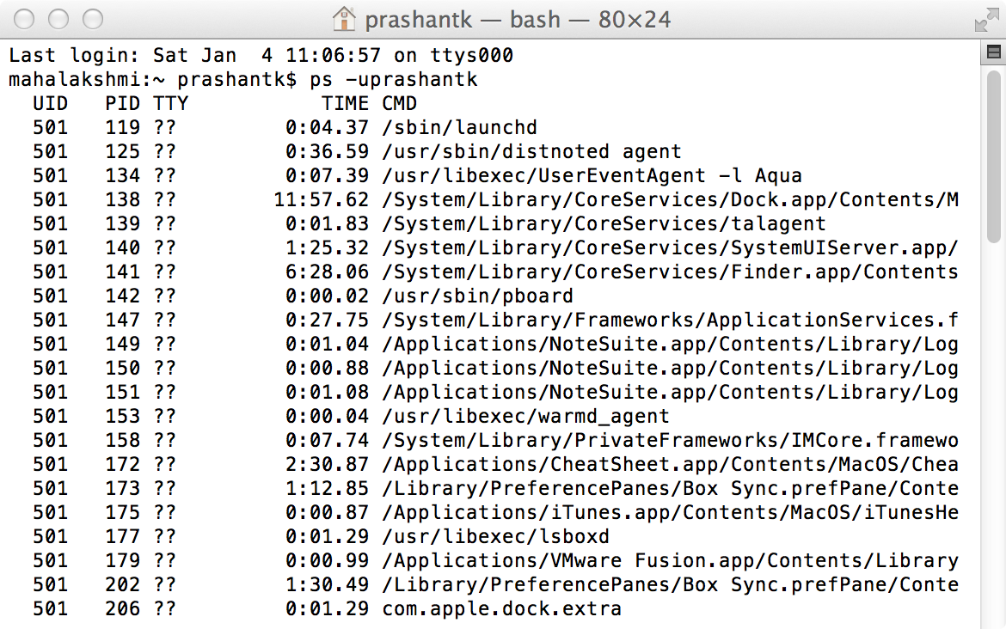
Client Process
Somewhere in this list of processes will be an instance of the browser that Alice is using
Say: firefox
It has a “process identifier”

Slide 35
Networked Applications
Processes on computers can communicate
Communicate = exchange some commands, responses, data
If the processes are on the same end-host, they use “inter-process communications”
Rules for exchanging data are based on the operating system
If the processes are on different hosts, they have to communicate over a network
Maybe different operating systems
Use messages to communicate
Sending process sends a message, receiving process picks up the message

Slide 36
Client and server processes
Alice’s browser is a client process running on her computer
It communicates with a server process that is running somewhere on some machine in Amazon.com’s network
Client initiates the contact (through the URL)
Server responds to the contact
It has information about the client in the message that the client sends to the server

Slide 37
Sockets
So what is a protocol?
Programming interface used by a process to send and receive messages
Like the door to a house
Sending process sends the message to the socket
Assumption: There is something outside the door to transport the message to the door of the receiving process
At the door of the receiving process (socket), the message is received and pushed to the process
Application developer has little control over what is outside the door, only controls the process
Can select from a set of “transport” protocols and some parameters

Slide 38
Protocols
Mac OS X Dictionary
“the accepted or established code of procedure or behavior in any group, organization, or situation: what is the protocol at a conference if one's neighbor dozes off during the speeches?”
“a set of rules governing the exchange or transmission of data between devices”
Recall
Processes have to exchange data
They send and receive messages
The messages should follow some set of rules, so that the processes can recognize what is happening

Slide 39
Example of Protocol
Alice
Bob
Alice
Bob
Hello!
Hello!
Én nem beszélek
angolul
Hi. What can I
do for you?
???
Do you know where
I can find Dr. K?
time
There is a sending and receiving of messages towards accomplishing something
The rules are there to make sure the communicating parties understand each other

Slide 40
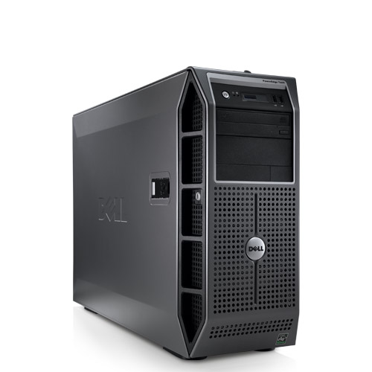
Example of Communication Protocol
Process uses TCP – transmission control protocol
TCP carries the request for amazon.com’s web page to the server
Server responds, also using TCP
Port number identifies the process at the TCP level
Layering!
TCP Connection
Request
TCP Connection
Response
Application
(Process)
Get
http://www.amazon.com
Socket
TCP
File in
pieces

Slide 41
Network Protocols
They are protocols needed for network components to interact and enable information flows
Protocols define format, order of messages sent and received among network entities, and actions taken on message transmission, receipt
Circuit Switching
Signaling protocols to set up/tear down circuit (e.g., SS7)
Packet Switching
Protocols to control flow of information (e.g., TCP)

Slide 42
Layering in Network Protocols
Networks make extensive use of layering of technology and protocols
Protocols are most often placed in layers
Layering is arranging functionality in a hierarchical manner, such that
Lower layers provide functions and services that support the functions and services of higher layers
Protocol layers are implemented in hardware or software
Some are implemented in the operating system kernel (e.g., TCP and IP)
Physical and link layers are implemented in hardware or firmware

Slide 43
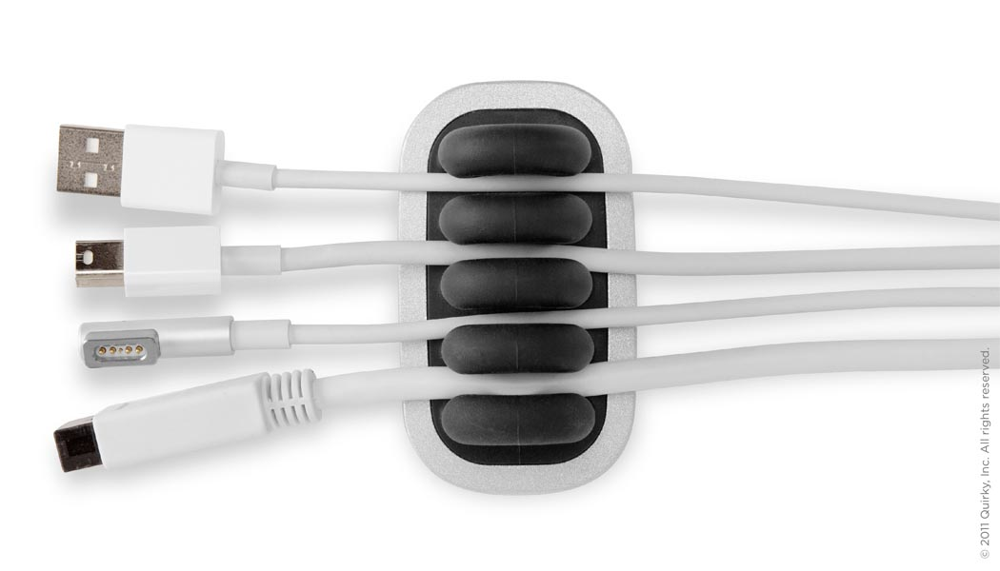
Advantages of layering
Slide modified from Agrawal
Well defined and specified
Modularity reduces complexity of implementation
Specializes technology development
Separation of functionality
Simplification in upgrades
Example: Change from IPv4 to IPv6 does not require change in email clients or browsers
Simplification in adding new technology
Adding wireless network capability does not require change in web site addresses (URLs)

Slide 44
Next class
More about layering and the protocol layers
The OSI and TCP/IP protocol stack models
Trying to understand how the “browsing Amazon.com” works in the context of protocol layers

